Slide 1
BCOG 100
Lecture 1.0: Course Overview

Slide 2
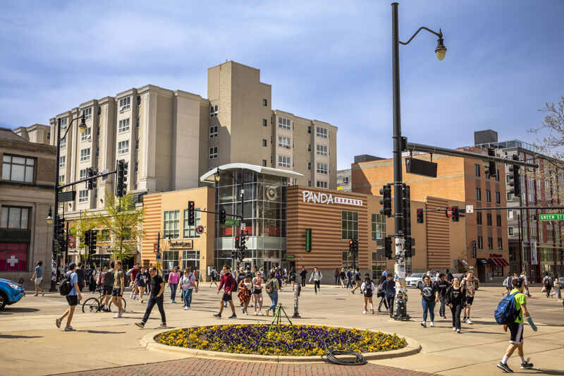

Slide 3


Slide 4
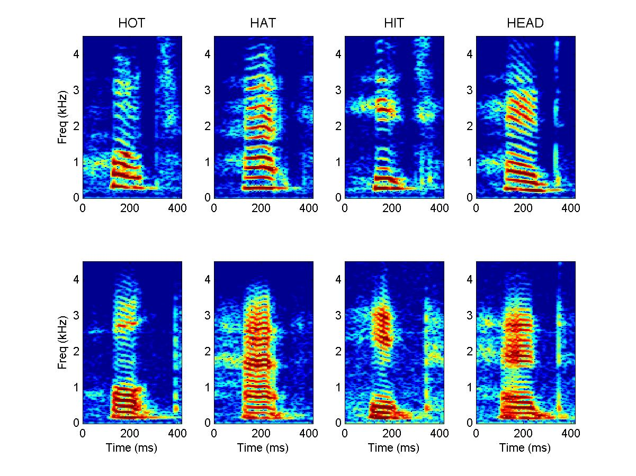

Slide 5


Slide 6


Slide 7


Slide 8
Our Schedule
Week 1: BCS Overview
Week 2: Philosophy of Mind (NO CLASS Mon Sep 1 and Fri Sep 5)
Week 3: Philosophy of Mind
Week 4: Neurons and Information Processing
Week 5: Neural Circuits
Week 6: Brains
Week 7: Associative and Reinforcement Learning
Week 8: Memory and Generative Models
Week 9: Social Cognition
Week 10: Language and Symbolic Thought
Week 11: Cognitive Psychology and Cognitive Neuroscience
Week 12: Machine Learning & AI
Week 13: Large Language Models (NO CLASS Fri Dec 12 )
Week 13: FALL BREAK
Week 14: Nature vs. Nurture 1
Week 15: Nature vs. Nurture 2 (NO CLASS Fri 12/12)

Slide 9
What is Brain and Cognitive Science?
The study of the mind and the brain, with two notable properties:
Interdisciplinary
Computational

Slide 10

Interdisciplinary BCS
Psychology
Neuroscience
Philosophy
Computer Science and Artificial Intelligence
Anthropology
Linguistics
Education
Ecology and Evolutionary Biology

Slide 11
Computational BCS
Computational Methods
Computer-based experiments
Computer-driven tools like EEG & fMRI
Complex data analysis
Computational models and simulations
Computational Metaphor
Is the mind or brain like a computer?
What do we gain by treating it as such?
What do we lose?

